Slide 1

Corey’s Super Exciting GSRSMRPI Presentation!
An Introduction to Machine Learning Algorithms

Slide 2

Machine Learning
Machine learning (ML) is a topic combining aspects from numerous fields in which algorithms are trained to learn from data to answer questions
There are 3 main types of ML:
supervised learning
unsupervised learning
reinforcement learning

Slide 3
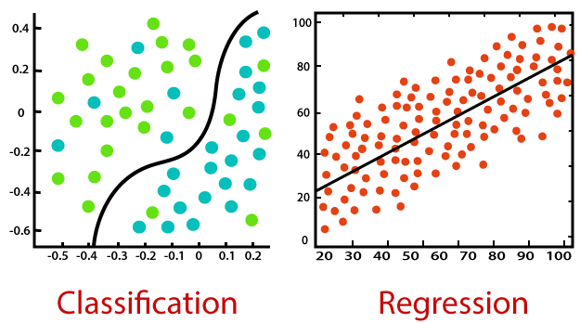
Supervised Machine Learning
Supervised ML can be further subdivided into two main subsets:
Classification
Regression

Slide 4

Classification
There are many different classification algorithms which we can generate:
Logistic Regression
K Nearest Neighbor
Support Vector Machine
Decision Tree
Random Forest
Neural Network

Slide 5
But First…

Slide 6
Preprocessing
Before we can build these models, we need to prepare the data:
Feature Scaling
Train/Test Splitting

Slide 7
Model Development
Now for the Fun Part…

Slide 8
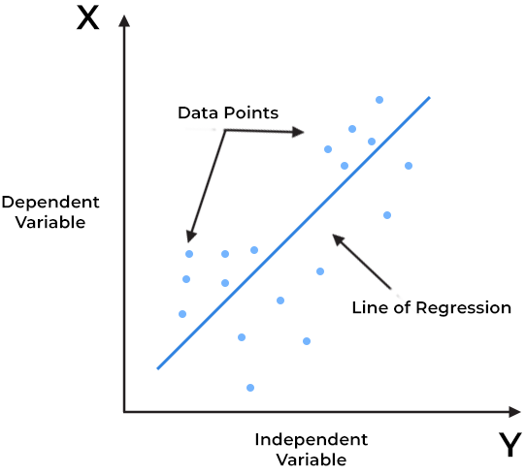










Linear Regression
Fits a set of data to an affine function

Slide 9
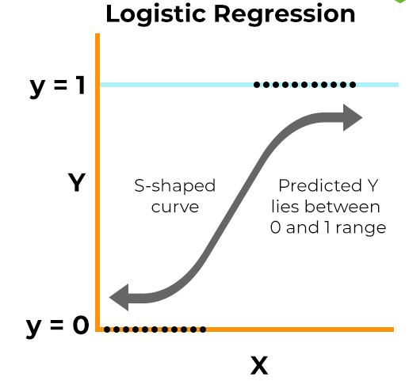

Logistic Regression
Applies sigmoid/softmax function to an affine transformation

Slide 10
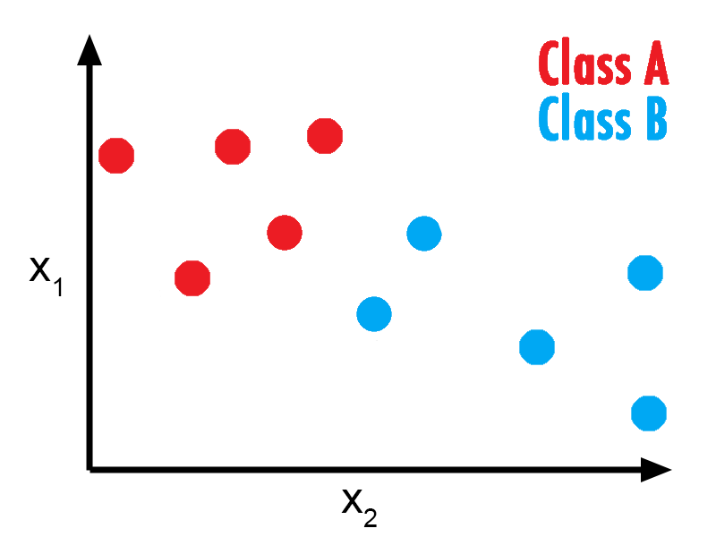
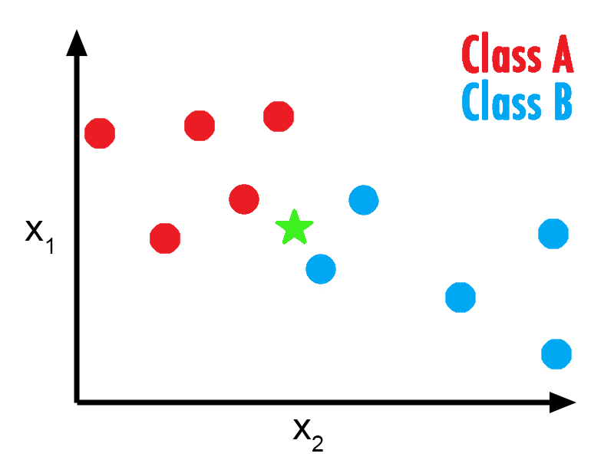
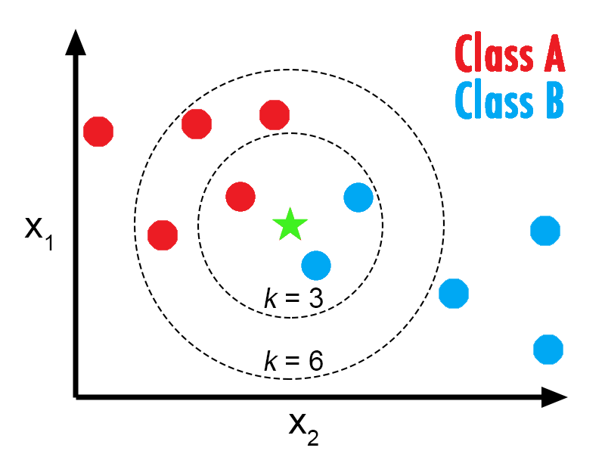
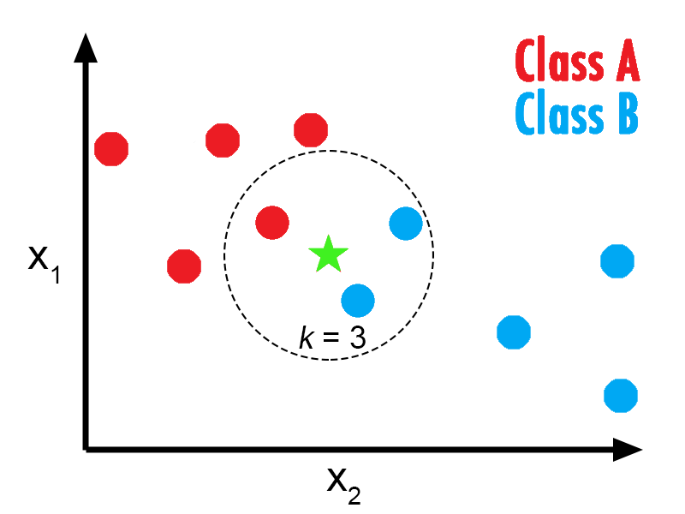
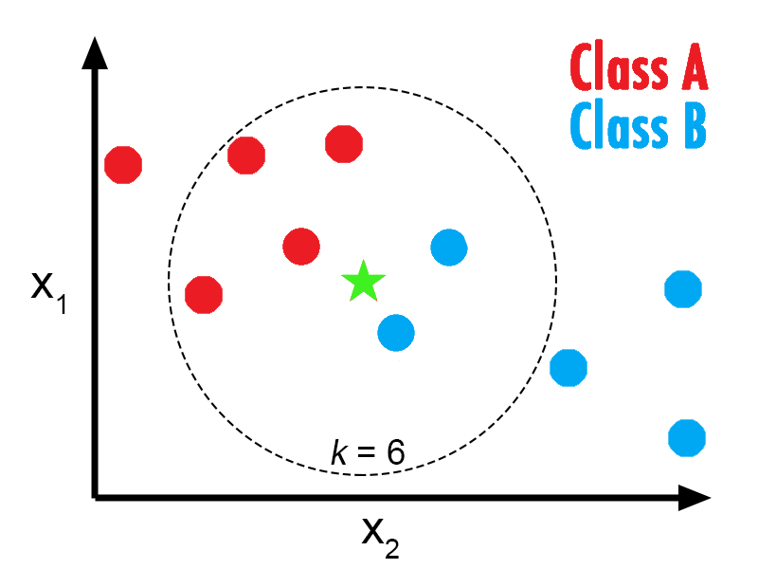
K Nearest Neighbor
KNN looks at the k closest datapoints for which we know the class to each new datum

Slide 11
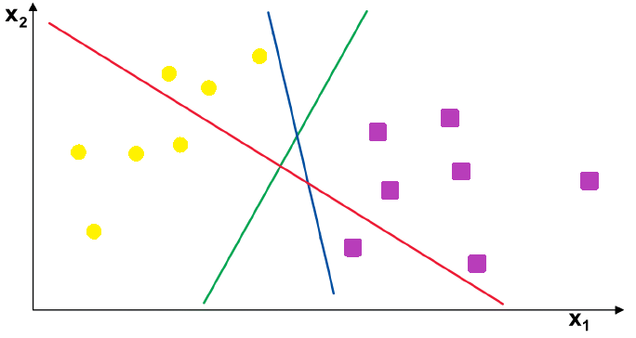
Support Vector Machine
SVM maximizes the distance between a line separating the classes and the points closest to it
Notes:
Min [1/n*sum(max{0,1-yi*(w^{T}xi-b)})]+lambda*||w||²

Slide 12
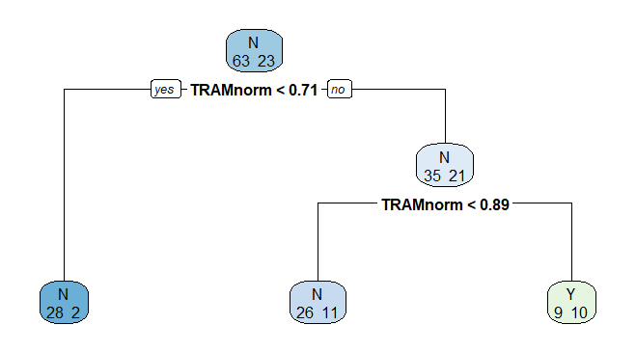
Decision Tree
Decision Trees make a sequence of binary decisions based on the data
Notes:
* Add how it makes the decisions mathematically

Slide 13
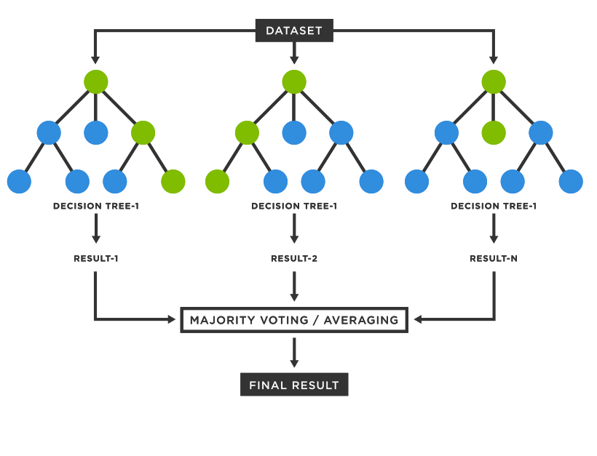


Random Forest
A Random Forest is a large collection of Decision Trees
Whichever class is predicted most often within the trees in the forest corresponds to the prediction of the forest

Slide 14
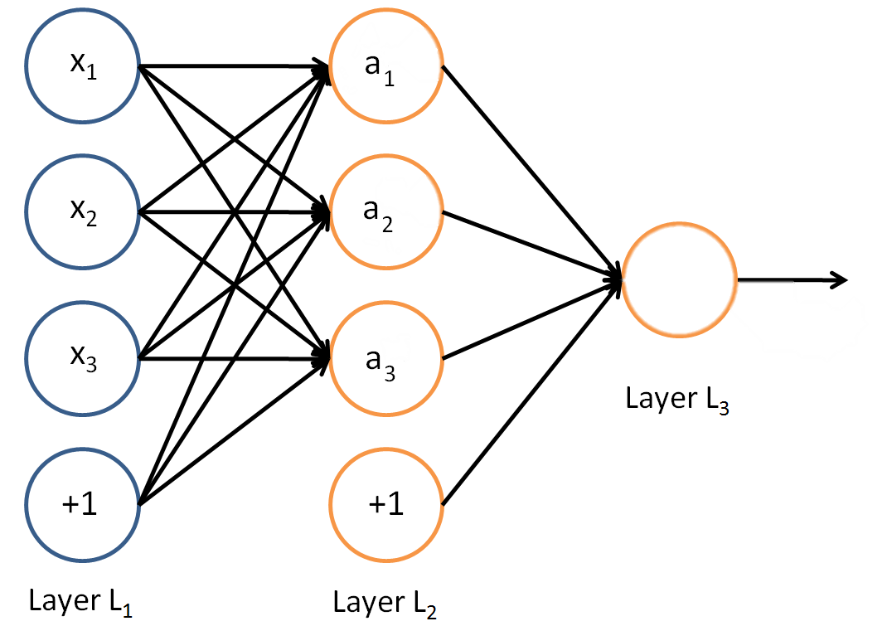
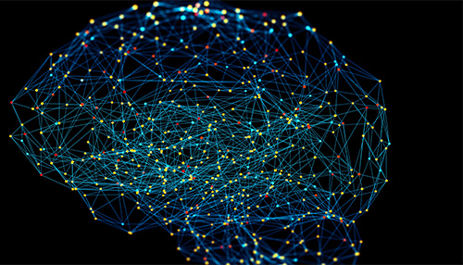
Neural Network
Neural Networks mimic the way the human brain interprets data
y
Notes:
* Lot more details here

Slide 15
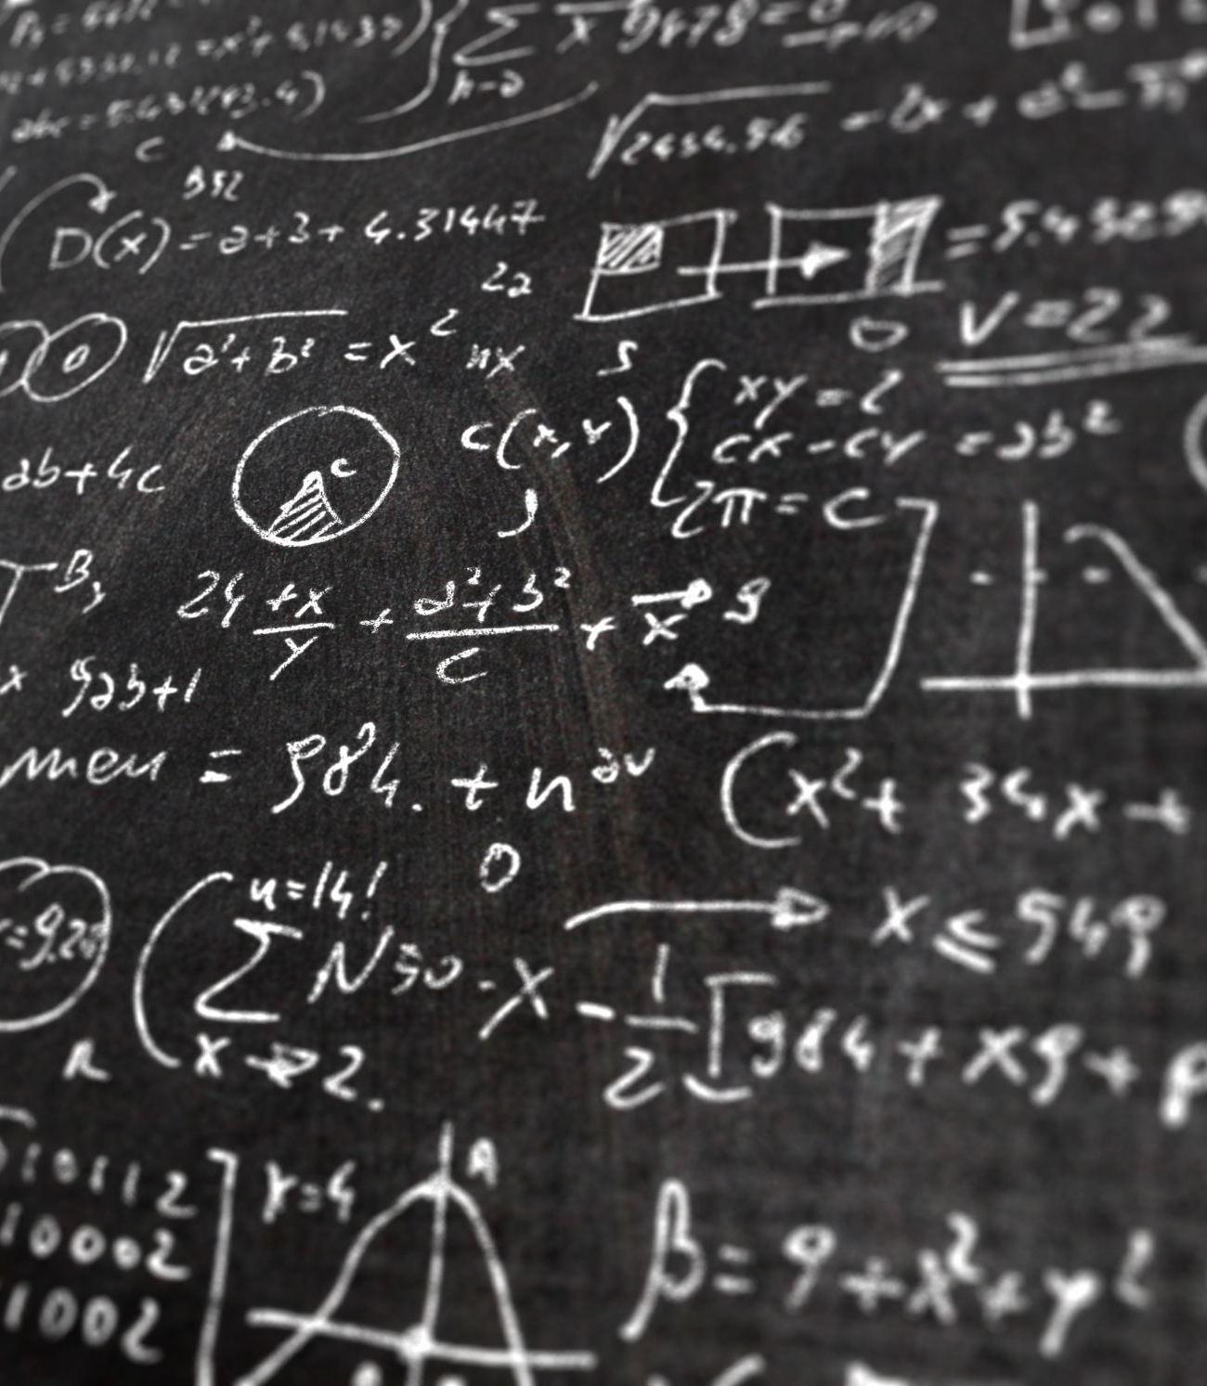
Further Work
Regression!
More complicated models

